Slide 1
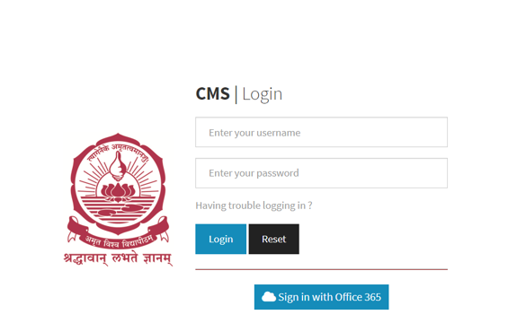

Slide 2
Gate pass management system
Apply pass
Time extension

Slide 3
Pass type :
Home pass / day pass
From :
Dd/mm/yy
time
Till :
Dd/mm/yy
time
Applying pass to :
Class advisor / resident warden
Reason for applying pass :
proceed

Slide 4
Confirmation page
This is to acknowledge that you have requested for a Day Pass for 1 day from Tue, Nov 15, 2022 6:30 PM to Tue, Nov 15, 2022 7:00 PM.Occassion : OtherPlease check your Passes List to know the status of your Gate Pass.Your pass request will be expired at 19:00 on Nov 15, 2022
This is to acknowledge that you have requested for a Day Pass for 1 day from date and time to date and time .
Occassion : OtherPlease
Please check your passess List to know the status of your Gate Pass.
Your pass request will be expired at date and time.
back
Apply pass

Slide 5
Passes list
Dd/mm/yy
till
Dd/mm/yy
Show all
pending
issued
cancelled
expired
all
rejected
used
S.No | Applid from | Applied till | Pass type | Warden Name | Acted on By | Advisor Name | Advisor Approval | Wardens Approval | Pass Status | Occassion

Slide 6
Extension Pass
Applied Pass:
It shows the applied pass date and timings
Extension Pass:
Timings of Extension
Valid Reason :
Reason for extension
Apply Pass

